Slide 1

DEG EXPLORATION OF BMP SIGNALING FOR OVARIAN CANCER THERAUPETIC AGENT
Ashar kurnia dian prambodo

Slide 2
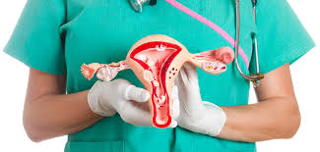
OVARIAN CANCER
Ovarian cancer is the most lethal gynaecologic cancer
70 % OC patient have high serious carcinoma
Surgery and chemotherapy is a standard treatment -> But, OC recurs after initial treatment.

Slide 3
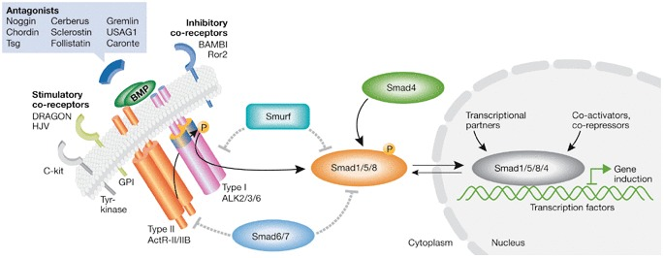
BMP signalling
Bone morphogenic protein (BMP) belong to transforming growth factor β (TGF- β) family which have two type receptors and to induce phosphorylation of SMAD1/5/8.

Slide 4
Purposes
Explore gene expression of BMP signaling for downstream analysis such as drug discovery to treat ovarian cancer.

Slide 5
Method
Data Collection
RNA seq of OC samples obtained from EBI.
DEG analysis
Performed using Deseq2 package R software.
GO Enrichment performed using clusterProfile package R software.
(https://www.ebi.ac.uk/gxa/experiments/E-MTAB-9479/Experiment%20Design).
Adjustment p-value < 0.05 , log2 fold change > 2 for upregulated gene, and log2 fold change < 0.5 for downregulated gene.
Pick top 10 core genes
Data Wrangling
GO Enrichment and KEGG Pathway Analysis
Separate count data and metadata.
Remove NA
KEGG pathway build with DAVID

Slide 6
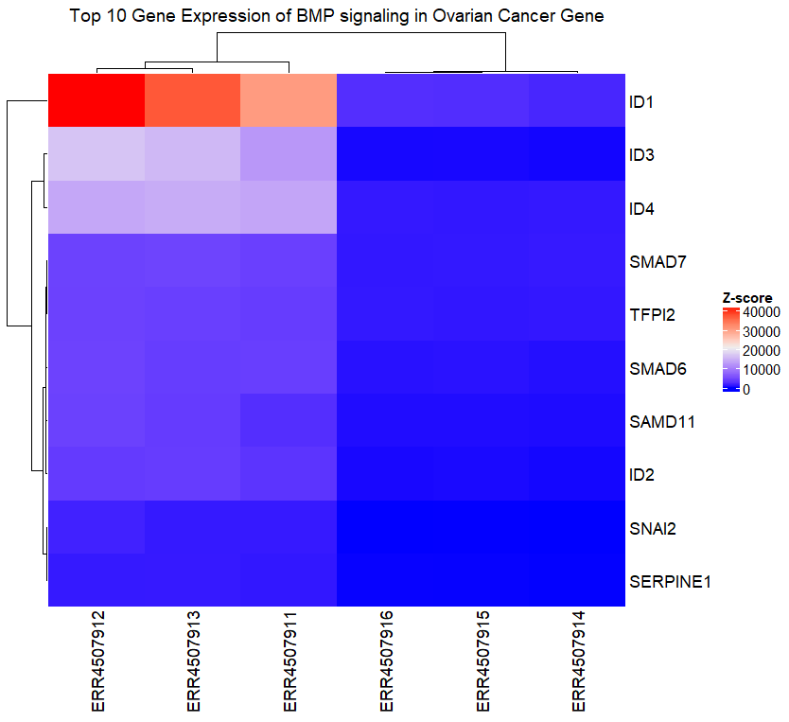
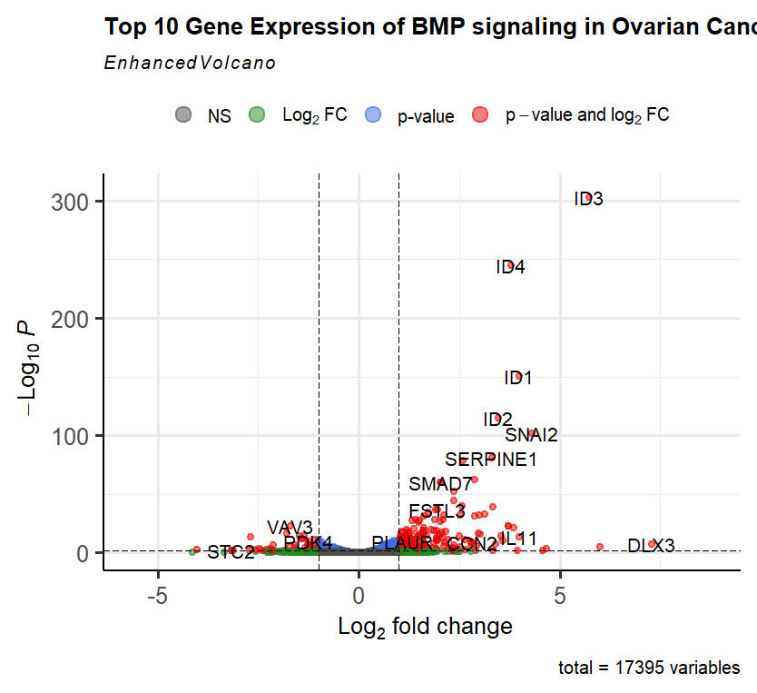
Result
Fig.2 Top 10 Gene Expression of BMP signalling in Ovarian Cancer volcano plot.
Fig.1 Top 10 Gene Expression of BMP signalling in Ovarian Cancer volcano plot

Slide 7
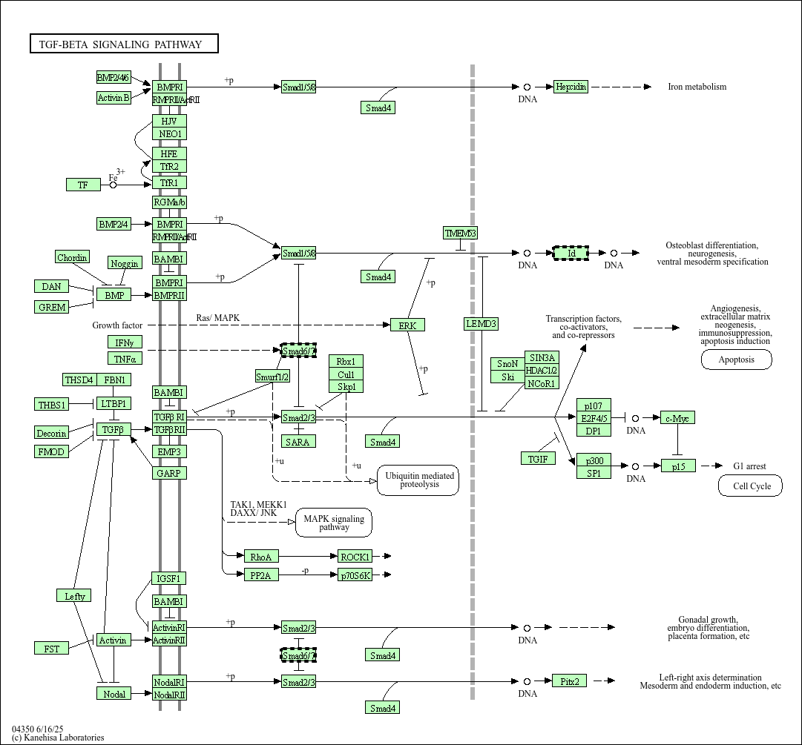
Result
Fig.3.TGF-β signalling pathway.

Slide 8
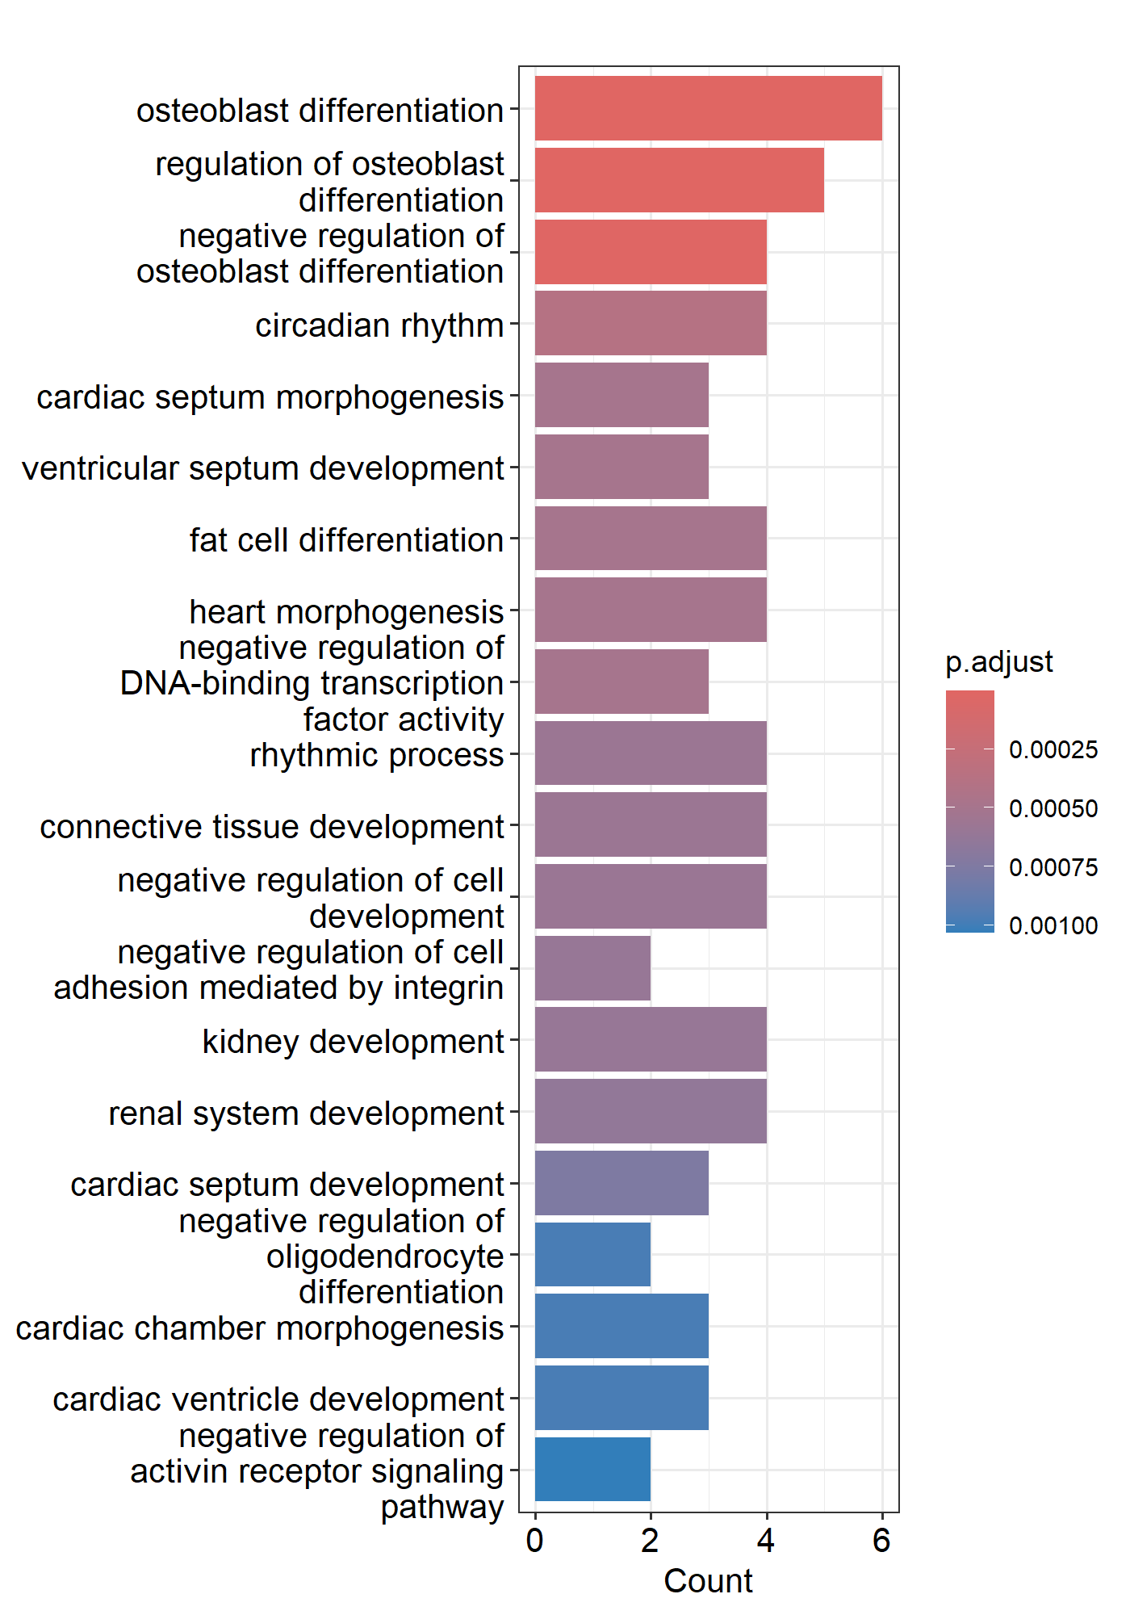
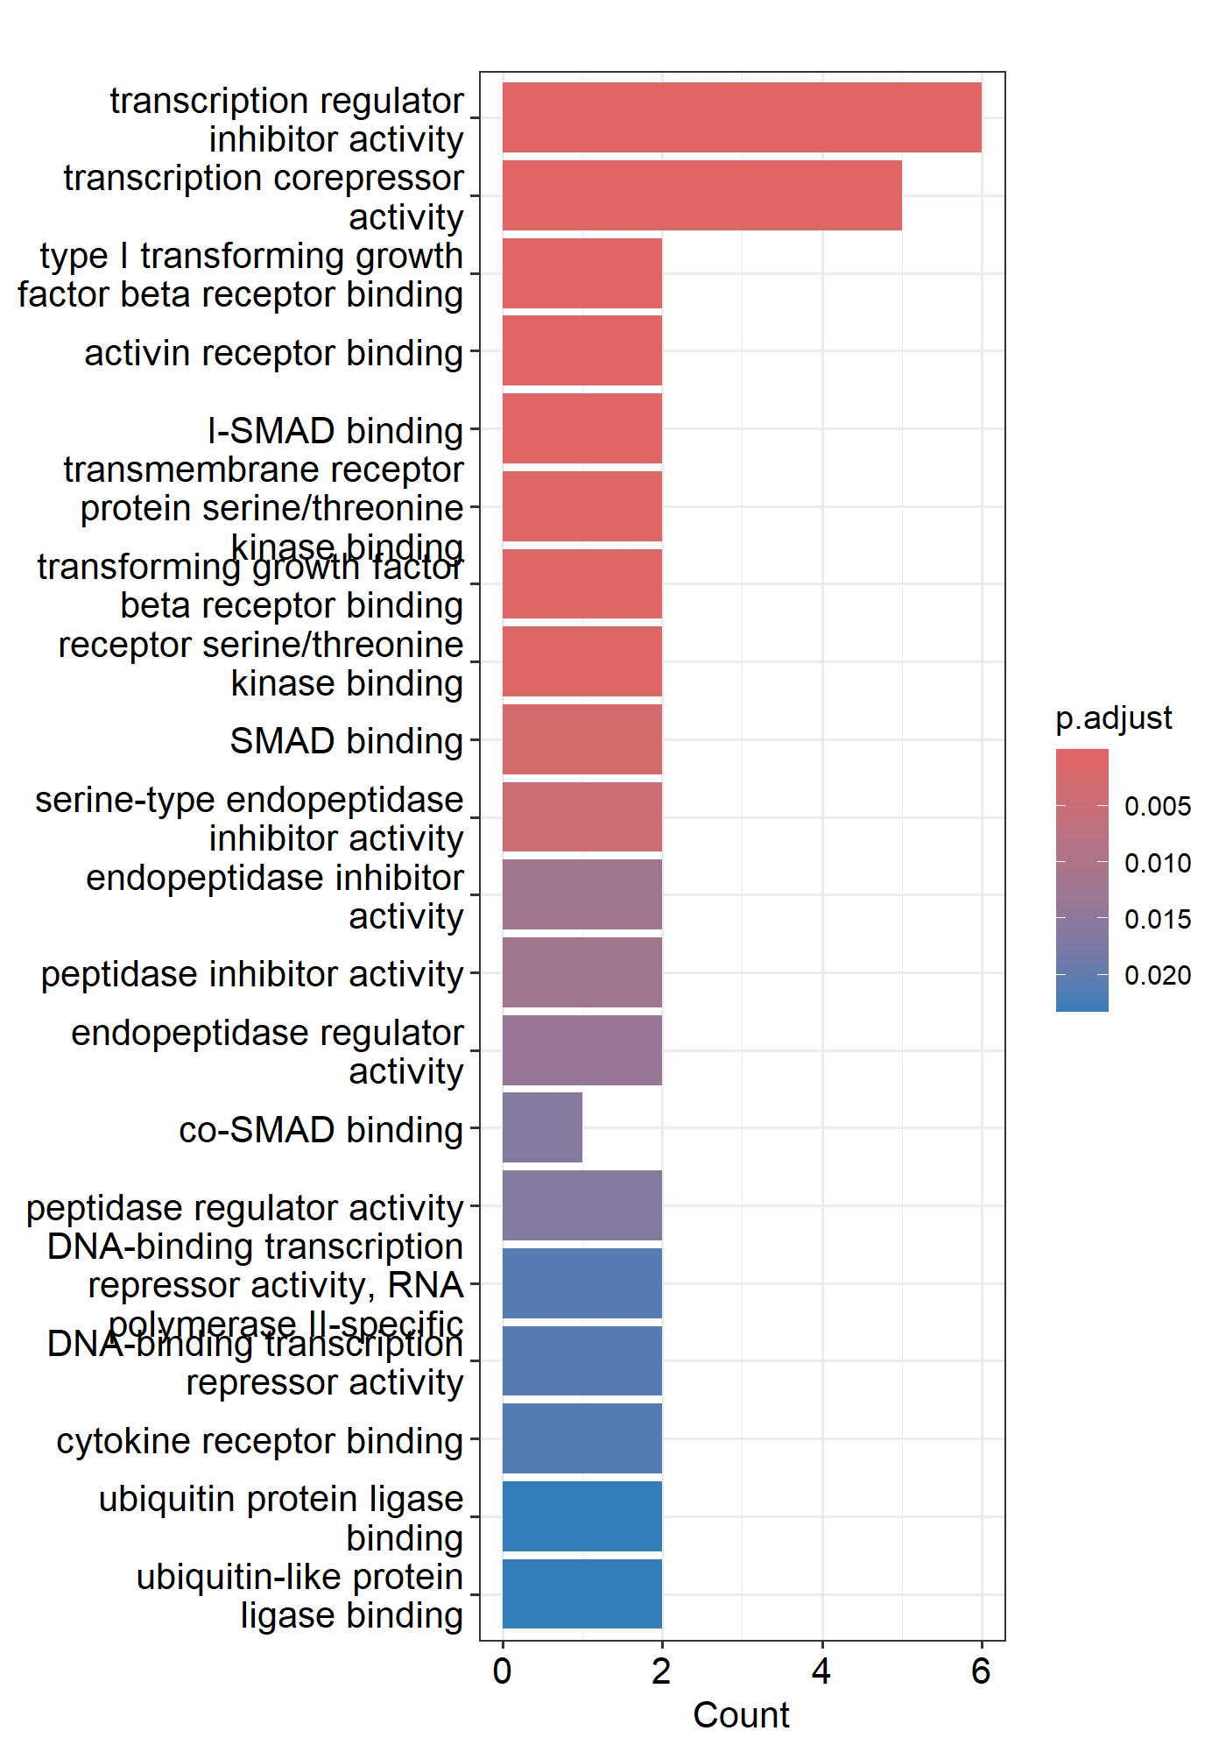
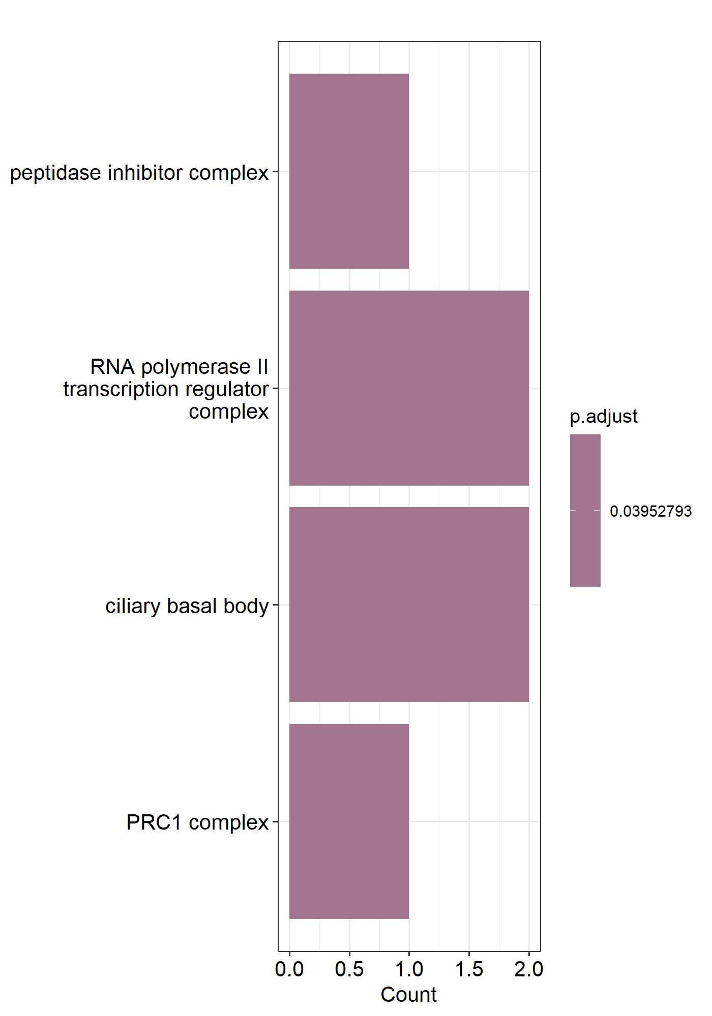
Result
Fig.4.A GO enrichment BP aspect
Fig.4.B GO enrichment MF aspect
Fig.4.C GO enrichment CC aspect

Slide 9
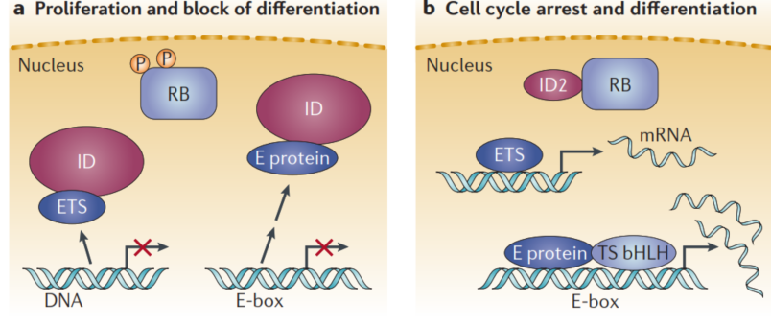
Discussion
High levels ID proteins in tumorigenesis is likely to be mediated by the inhibition of basic helix-loop-helix (bHLH) transcription factors and cell differentiation
bHLH proteins are transcription factors that bind to cognate E-box sequences and induce the expression of specific genes including those that promote differentiation of stem cell or progenitor cells (Lee et al., 2022).

Slide 10
Conclusion
BMP signalling have a roles in OC development and the DEG analysis proves that ID family genes from BMP signalling downstream process are correlated with bHLH inhibition. Thus, BMP signalling inhibitor potentially can used for therapeutic target for cure ovarian cancer

Slide 11
Thank You

